Slide 1
Copying 10 bytes of data from source address to destination address
LDR r0,=0x20000000 ; Source address
LDR r1,=0x20000050 ; Destination address
LDR r2,=10 ; number of bytes to copy
copy_loop
LDRB r3, [r0] ; read 1 byte
ADDS r0, r0, #1 ; increment source pointer
STRB r3, [r1] ; write 1 byte
ADDS r1, r1, #1 ; increment destination pointer SUBS r2, r2, #1 ; decrement loop counter BNE copy_loop ; loop until all data copied

Slide 2
Moving the contents from Source to Destination Address
LDR r0,=0x20000000 ; Source address
LDR r1,=0x20000100 ; Destination address
LDR r2,=50 ; number of bytes to copy, also
copy_loop ; acts as loop counter
SUBS r2, r2, #1 ; decrement offset and loop counter
LDRB r4,[r0, r2] ; read 1 byte
STRB r4,[r1, r2] ; write 1 byte
BNE copy_loop ; loop until all data copied
By using the loop counter as a memory offset, we have reduced usage of more no of instructions

Slide 3
Read and store significance of !
LDMIA R0!, {R1, R2, R5 & R7} ; Read multiple registers, R0 update to address after last read operation.
STMIA R0!, {R1, R2, R5 & R7} ; Store R1, R2, R5, R6, and R7 to memory; and update R0 to address after where R7 stored

Slide 4
128 Bytes to be copied
LDR r0,=0x20000000 ; Source address
LDR r1,=0x20000100 ; Destination address
LDR r2,=128 ; number of bytes to copy, also
copy_loop ; acts as loop counter
LDMIA r0!,{r4-r7} ; Read 4 words and increment r0
STMIA r1!,{r4-r7} ; Store 4 words and increment r1
LDMIA r0!,{r4-r7} ; Read 4 words and increment r0
STMIA r1!,{r4-r7} ; Store 4 words and increment r1
LDMIA r0!,{r4-r7} ; Read 4 words and increment r0
STMIA r1!,{r4-r7} ; Store 4 words and increment r1
LDMIA r0!,{r4-r7} ; Read 4 words and increment r0
STMIA r1!,{r4-r7} ; Store 4 words and increment r1
SUBS r2, r2, #64 ; Each time 64 bytes are copied
BNE copy_loop ; loop until all data copied

Slide 5
64 Bit Addition
LDR r0,=0xFFFFFFFF ; X_Low (X ¼=0x3333FFFFFFFFFFFF)
LDR r1,=0x3333FFFF ; X_High
LDR r2,=0x00000001 ; Y_Low (Y ¼=0x3333000000000001)
LDR r3,=0x33330000 ; Y_High
ADDS r0,r0,r2 ; lower 32-bit
ADCS r1,r1,r3 ; upper 32-bit

Slide 6
Implementation of FOR LOOP
Total = 0;
for (i=0;i<5;i=i+1)
Total = Total + i;
//Assume “Total” is R0 and “i” is R1; the program can be implemented as
MOVS R0, #0 ; Total = 0
MOVS R1, #0 ; i = 0
loop
ADDS R0, R0, R1 ; Total = Total + i
ADDS R1, R1, #1 ; i = i + 1
CMP R1, #5 ; compare i to 5
BLT loop ; if less than then branch to loop

Slide 7
Function
function1
SUB SP, SP, #0x8 ; Reserve 2 words of stack ;(8 bytes) for local variables ;Data processing in function
MOVS r0, #0x12 ; set a dummy value
STR r0, [sp, #0] ; Store 0x12 in 1st local variable
STR r0, [sp, #4] ; Store 0x12 in 2nd local variable
LDR r1, [sp, #0] ; Read from 1st local variable
LDR r2, [sp, #4] ; Read from 2nd local variable
ADD SP, SP, #0x8; Restore SP to original position
BX LR
__main
BL function1
stop B stop

Slide 8
Calling Function from other file
PRESERVE8 ; Indicate the code here preserve
; 8 byte stack alignment
THUMB ; Indicate THUMB code is used
AREA |.text|, CODE, READONLY
EXPORT __main
EXTERN func
; Start of CODE area
__main
LDR r0,=0x10;
BL func
stop B stop
END

Slide 9
Called Function-(2x+9)
PRESERVE8
THUMB
AREA |.text|, CODE, READONLY
EXPORT func
func
push {r0}
LDR R2,[r13];
MOVS R3,#2
MULS R2,R3,R2
ADDS r2,r2,#9
STR r2,[R13]
pop {r1}
BX LR
END

Slide 10
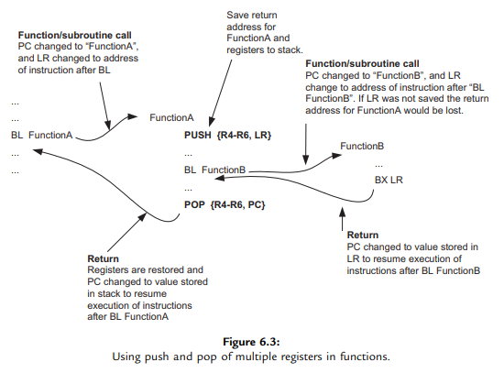
Nested Function

Slide 11
Main Function
PRESERVE8 ; Indicate the code here preserve
; 8 byte stack alignment
THUMB ; Indicate THUMB code is used
AREA |.text|, CODE, READONLY
EXPORT __main
EXTERN func
; Start of CODE area
__main
LDR r0,=0x10;
BL func
stop B stop
END

Slide 12
Code for calling func
PRESERVE8
THUMB
AREA |.text|, CODE, READONLY
EXPORT func
EXTERN func2
func
push{LR}
MOVS R1,#08
BL func2
pop{PC}
END

Slide 13
func calling func2
PRESERVE8
THUMB
AREA |.text|, CODE, READONLY
EXPORT func2
func2
MOVS r2,#08
BX LR
END

Slide 14
USING BICS and ORRS to Set the priority register with priority levels.
The 4 priority register levels are
1.00
2.40
3.80
4.C0
When we are require to set interrupt priority level with 00 having higher priority and CO having lowest priority into a register mapping to a particular interrupt, we use this code.
__main
ldr r0,=0x20000000
ldr r1,=0xffffffff
movs r2, #0xff
lsls r2,r2,#16
bics r1,r1,r2
movs r2, #0xc0
lsls r2,r2,#16
orrs r1,r1,r2
str r1,[r0]
stop b stop
end

Slide 15
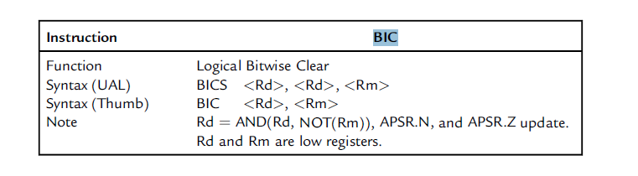
BIC (Logical Bitwise Clear)

Slide 16
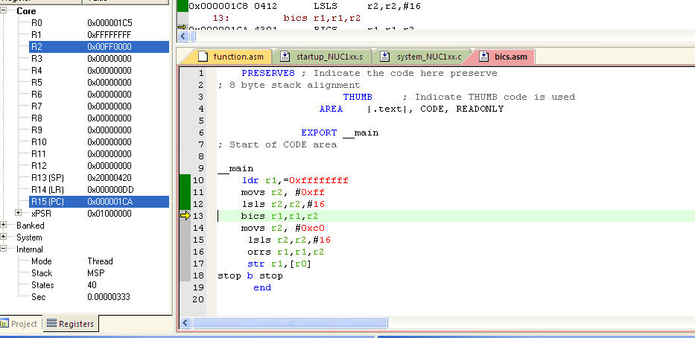

Slide 17
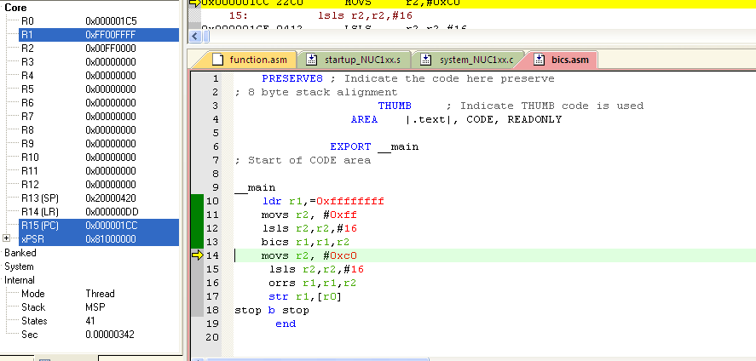

Slide 18
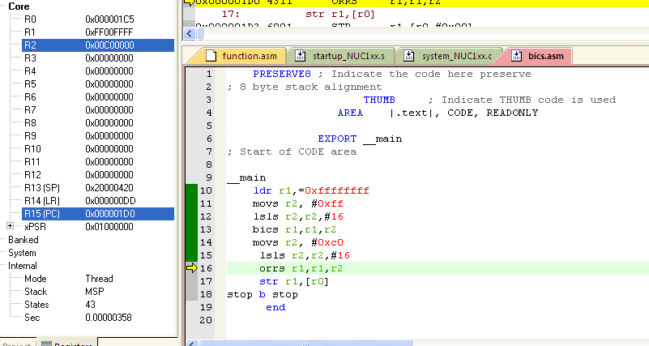

Slide 19
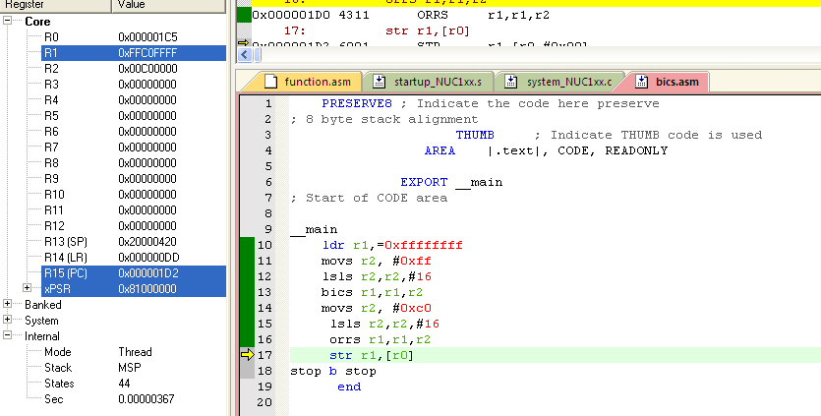

Slide 20
SWITCH
;CASE BRANCHING PRESERVE8 ; Indicate the code here preserve ; 8 byte stack alignment THUMB ; Indicate THUMB code is used AREA |.text|, CODE, READONLY EXPORT main ; Start of CODE area
__main
LDR R0, =0
CMP R0, #3 ; Compare input to maximum valid choice
BHI default_case ; Branch to default case if higher than 3
MOVS R2, #4 ; Multiply branch table offset by 4
MULS R0, R2, R0 ; (size of each entry)
LDR R1, =BranchTable ; Get base address of branch table(0x284)
LDR R2,[R1,R0] ; Get the actual branch destination
BX R2 ; Branch to destination
ALIGN 4 ; Alignment control. The table has
BranchTable ; to be word aligned to prevent unaligned read ;

Slide 21
Continued Switch
table of each destination address
DCD Dest0
DCD Dest1
DCD Dest2
DCD Dest3
default_case
stop B stop ; Instructions for default case
Dest0 ldr r0, =10
stop1 B stop1 ; Instructions for case ‘0’
Dest1 ldr r0, =20
stop2 B stop2 ; Instructions for case ‘1’
Dest2 ldr r0, =30
stop3 B stop3 ; Instructions for case ‘2’
Dest3 ldr r0, =40
stop4 B stop4 ; Instructions for case ‘3’
END

Slide 22
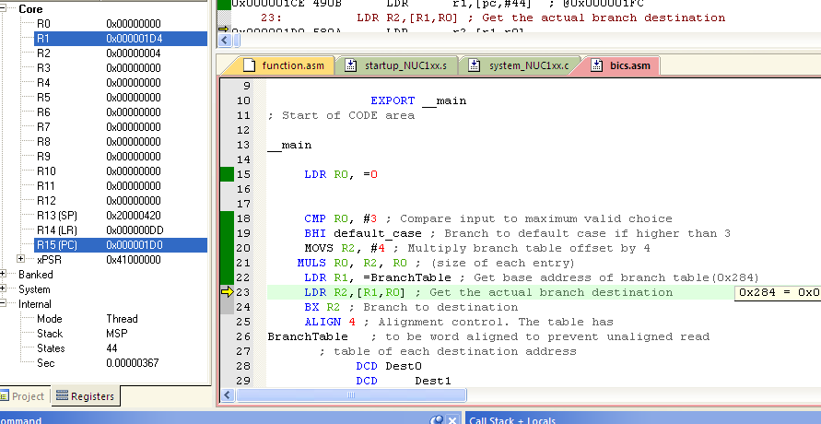

Slide 23
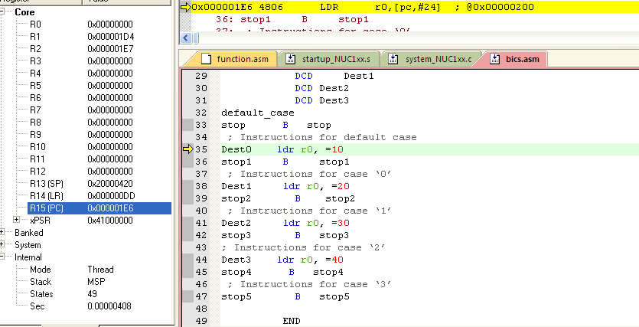

Slide 24
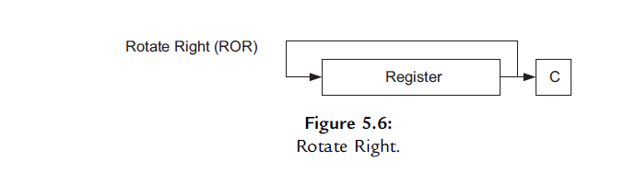
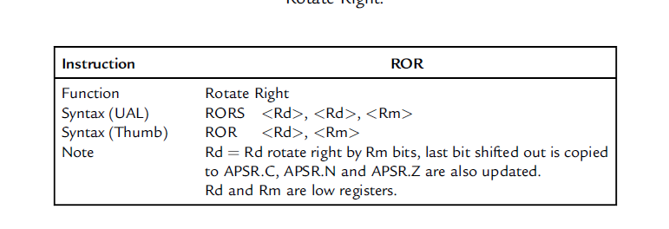
RORS

Slide 25
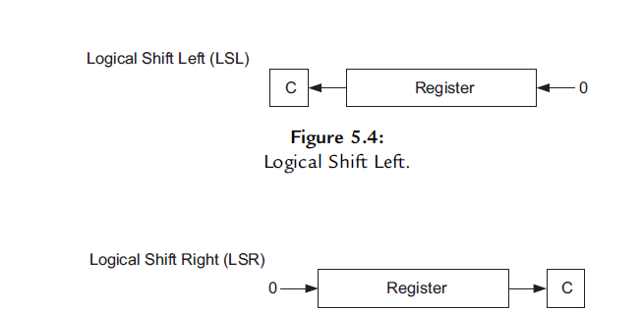
LSLS and LSRS
For logical shift operations, the instructions are LSL (Figure 5.4) and LSR (Figure 5.5).

Slide 26
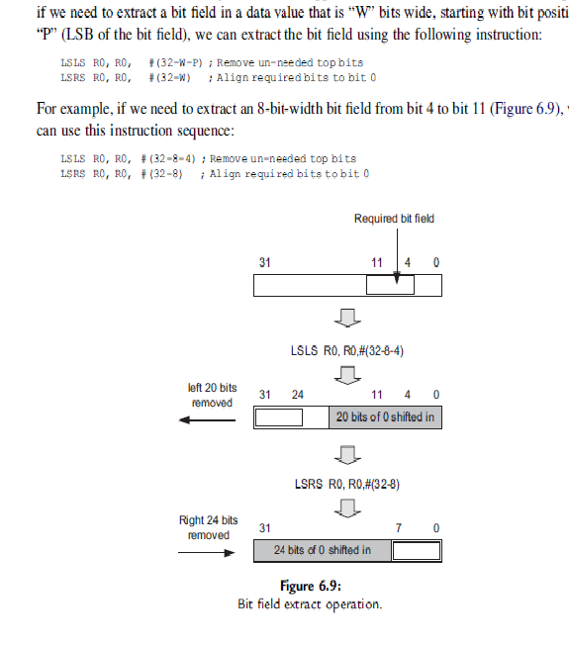
Extraction of data value with W bits wide and P is the starting position

Slide 27
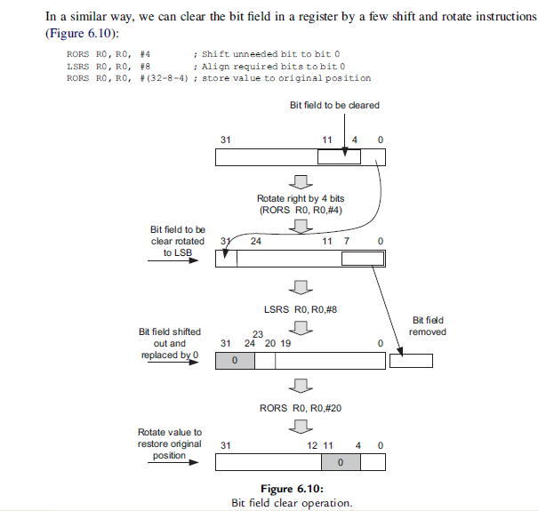
Clearing the bits starting position P and width of the field being W

Slide 28
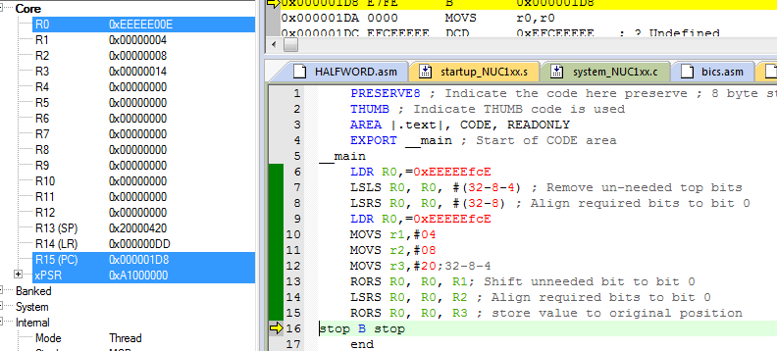
Extracting and Clearing the bits starting position P and width of the field being W

Slide 29
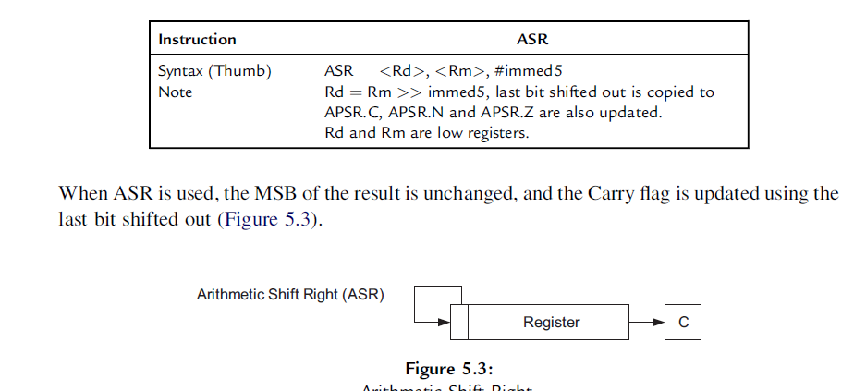
ASR

Slide 30
ASR
PRESERVE8 ; Indicate the code here preserve
; 8 byte stack alignment
THUMB ; Indicate THUMB code is used
AREA |.text|, CODE, READONLY
EXPORT __main
; Start of CODE area
__main
LDR r2,=0x00000080;
ASRS r0,r2,#04
LDR r2,=0x80000000;
ASRS r0,r2,#04
stop B stop
END

Slide 31
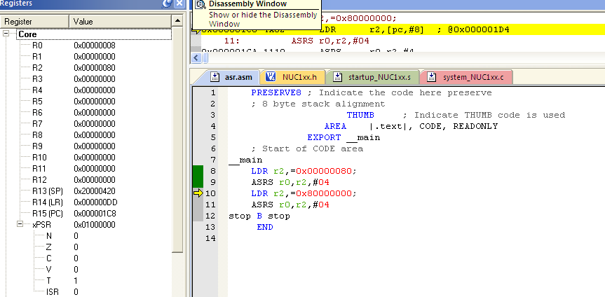

Slide 32
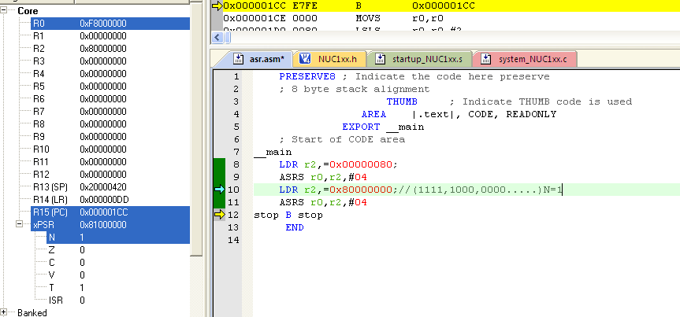

Slide 33
LSLS
PRESERVE8 ; Indicate the code here preserve
; 8 byte stack alignment
THUMB ; Indicate THUMB code is used
AREA |.text|, CODE, READONLY
EXPORT __main
; Start of CODE area
__main
LDR r0,=0x80000001;
LSLS r2,r0,#01
LDR r0,=0x80000001;
LSLS r2,r0,#02
stop B stop
END

Slide 34
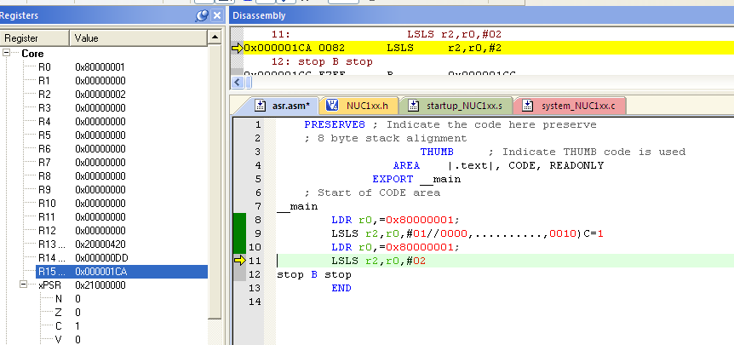

Slide 35
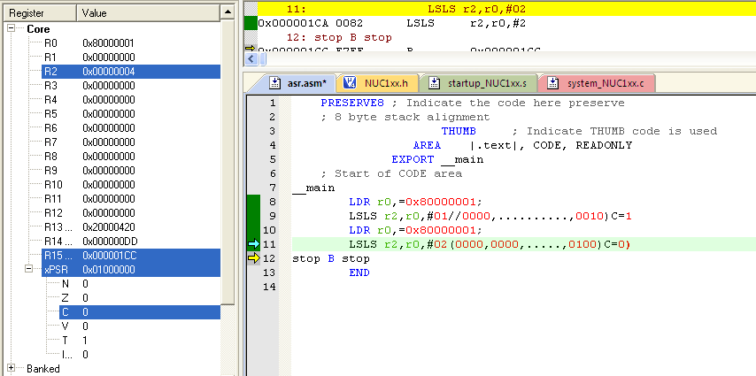

Slide 36
LSRS
PRESERVE8 ; Indicate the code here preserve
; 8 byte stack alignment
THUMB ; Indicate THUMB code is used
AREA |.text|, CODE, READONLY
EXPORT __main
; Start of CODE area
__main
LDR r0,=0x80000001;
LSRS r2,r0,#31
LDR r0,=0x80000001;
LSRS r2,r0,#30
stop B stop
END

Slide 37
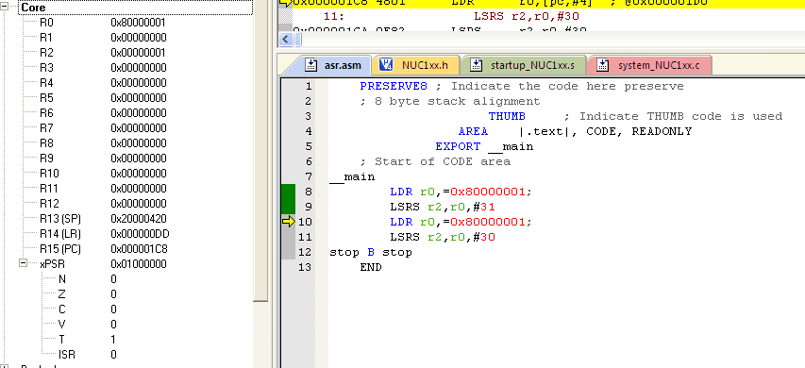

Slide 38
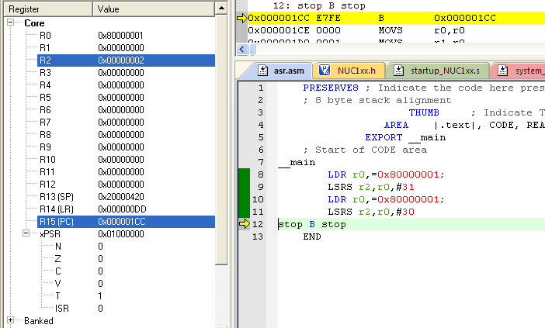

Slide 39
RORS

Slide 40
RORS
PRESERVE8 ; Indicate the code here preserve
; 8 byte stack alignment
THUMB ; Indicate THUMB code is used
AREA |.text|, CODE, READONLY
EXPORT __main
; Start of CODE area
__main
LDR r0,=0x80000001;
MOVS r2,#31;32-1
RORS r0,r2
LDR r0,=0x80000001;
MOVS r2,#30
RORS r0,r2
stop B stop
END

Slide 41
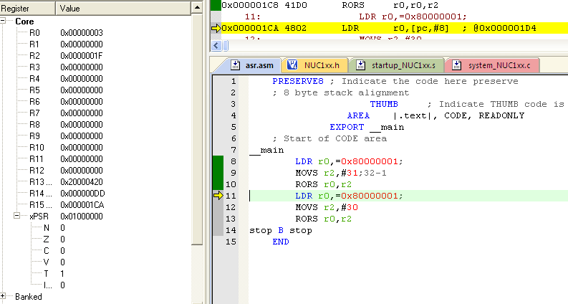

Slide 42
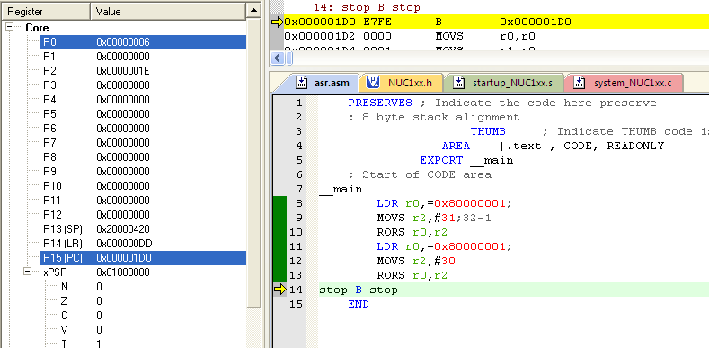

Slide 43
BIC (Logical Bitwise Clear)

